Slide 1
Title: Predicting the Outcome of Global Terrorist Activity
Name: Fahim Ahmed Shakil
Id: 1610736042
Section: 02

Slide 2
Dataset: We have collected the dataset from START(Study of Terrorism and Responses to Terrorism). It is a public dataset and regularly updated. It contains data of global terrorism from 1970 to 2018.

Slide 3
The dataset contains 135 features and 190,000 instances. We have used “Success” attribute as the target attribute which has two values - 0 and 1; depending on whether terrorist were able to carry out their activities or not. Therefore, this is a binary classification problem.

Slide 4
Data Preprocessing
Code:
le = LabelEncoder()
df_features = df_features.apply(le.fit_transform)
Firstly, I have seperated the dataset into feature set and label.
As all the feature datatypes were object/string, I have used “Label-Encoder” of “Sicikit-Learn” to convert the datatype of all the features to integer.

Slide 5
Baseline Accuracy
Code:
dummy_clf = DummyClassifier(strategy = "most_frequent", random_state = 0)
dummy_clf.fit(X_train, y_train)
score = dummy_clf.score(X_test, y_test)
print(score)
Using DummyClassifier on the transformed dataset, I have got an accuracy of : 88%.
It clearly shows that the dataset has class imbalance.

Slide 6
Handling Class Imbalance - SMOTE
Code:
sm = SMOTE(random_state=42, ratio=1.0)
X_train, y_train = sm.fit_sample(X_train, y_train)
To solve the bias of the dataset, I have used Synthetic Minority Over-sampling Technique (SMOTE).
After applying SMOTE to the dataset, the baseline classifier accuracy is : 11%

Slide 7
Feature Selection
Code:
model = ExtraTreesClassifier()
model = model.fit(df_features,df_label)
model = SelectFromModel(model, prefit=True)
df_features = model.transform(df_features)
For selecting the best features from the feature set of 134 features, I have used “Extra Tree Classifier”. It selects 60 features from the features set.

Slide 8
Dimensionality Reduction
Code:
scaler = StandardScaler()
scaler.fit(X_train)
X_train = scaler.transform(X_train)
X_test = scaler.transform(X_test)
pca = PCA(.95)
pca.fit(X_train)
X_train = pca.transform(X_train)
X_test = pca.transform(X_test)
To reduce the dimensionality of the dataset, I have used Principal component analysis (PCA). Firstly, I have standardize the feature set and then used “PCA” for dimensionality reduction.

Slide 9
Neural Network
For classification, I have used “Keras Sequential Model” using “Tensorflow” as backend.
I have build a fully connected 3 layers network. For this, I have used keras “Dense Class”.
I have used the “Rectified Linear Unit Activation (ReLU)” on the first two layers (which are hidden layers) and the “Sigmoid Function” in the output layer.
I have used sigmoid function on the output layer to ensure our network output is between 0 and 1 and get classification based on a default threshold of 0.5.

Slide 10
Neural Network
Code:
model = Sequential()
model.add(Dense(16, input_dim=feature_size, activation='relu'))
model.add(Dense(10, activation='relu'))
model.add(Dense(1, activation='sigmoid'))
model.compile(loss='binary_crossentropy', optimizer='adam', metrics=['accuracy'])
history = model.fit(X_train, y_train, validation_split=0.30,epochs=50, batch_size=100000)
_,accuracy = model.evaluate(X_test, y_test)
For the hidden layers I have used 16 and 10 nodes respectively.
For the output layer, I have used one node as it is a binary classification.
“Binary_crossentropy” have been used as loss function to evaluate weights and “adam” as optimizer which is a gradient descent algorithm.

Slide 11
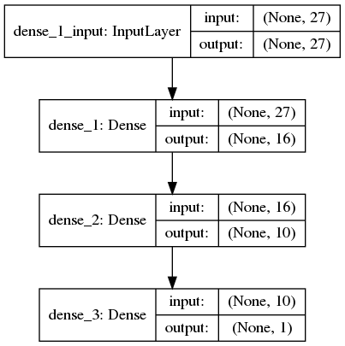
Neural Network
Summary of the Neural Network

Slide 12
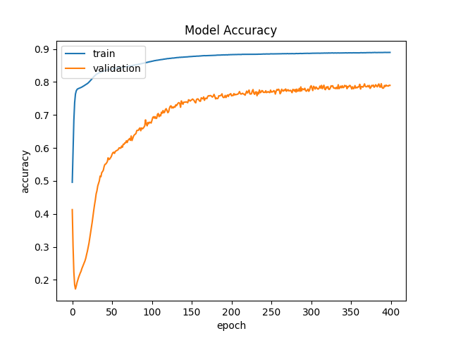
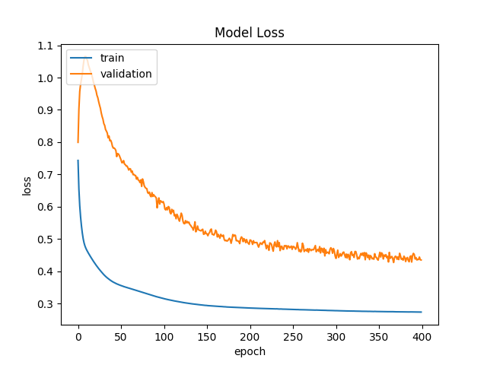
The model gives test accuracy of : 88%

